Slide 1

Sharing Session
Mask R-CNN using
We will learn together about some of computer vision problems, and will try Mask R-CNN architecture to solve the instance segmentation problems
Benedict Aryo

Slide 2
Agenda:
Mask R-CNN using Detectron2
Computer Vision Problems
RCNN Family
Mask RCNN
Why Detectron2
Practice using Detectron2
Training using Detectron2 (optional)
Benedict Aryo

Slide 3
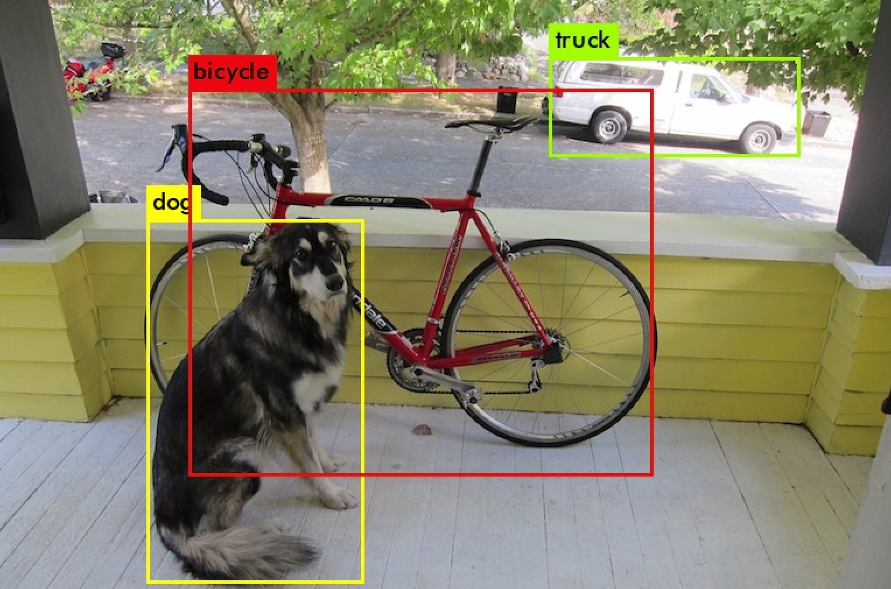
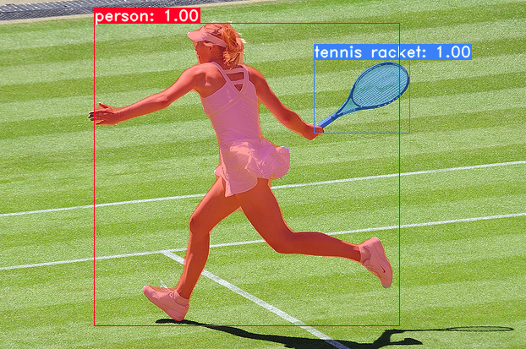
What I was thinking about...
Faster R-CNN
VS
Mask R-CNN
Benedict Aryo - Mask R-CNN using Detectron2

Slide 4
I though that...
Mask R-CNN = Faster R-CNN + Steroids
(or some magic)
But, is it true ?
Benedict Aryo - Mask R-CNN using Detectron2

Slide 5
Now I think that...
Mask R-CNN & Faster R-CNN
serve different purposes
Wait… what?
Benedict Aryo - Mask R-CNN using Detectron2

Slide 6
In fact...
This is
Not a Faster R-CNN
This is
Not a Mask R-CNN
YOLOv3:An Incremental Improvement. Joseph Redmond, Ali Farhadi. 2018
YOLACT: Real-time Instance Segmentation. Daniel Bolya, et. al. 2019
Benedict Aryo - Mask R-CNN using Detectron2

Slide 7
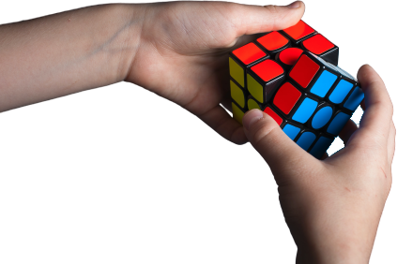
Understanding the objectives is essential to solving the problems

Slide 8
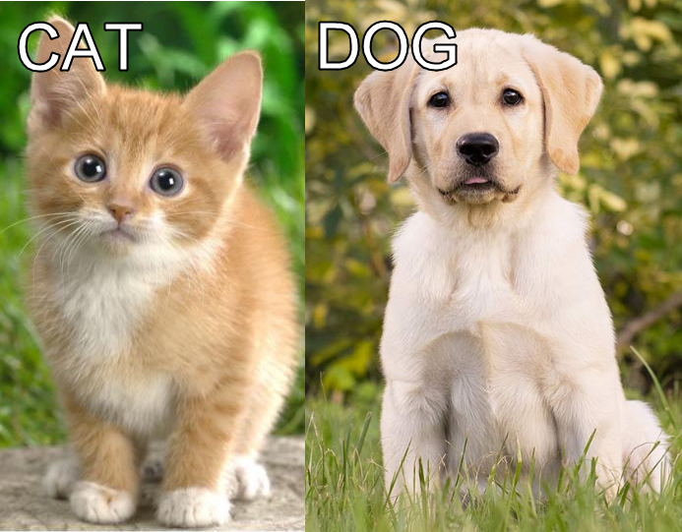
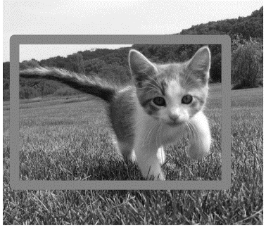
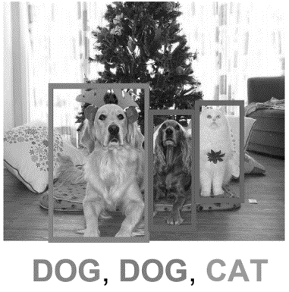
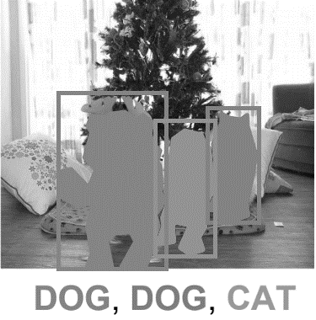
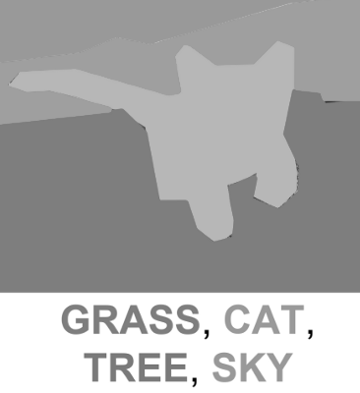
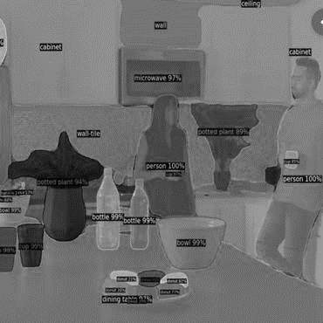
Problems in Computer Vision Image Recognition
Image Classification
Classification + Localization
Object Detection
Instance Segmentation
Semantic segmentation
Panoptic segmentation

Slide 9

Problems in Computer Vision Image Recognition
Image Classification
Classification + Localization
Object Detection
Instance Segmentation
Semantic segmentation
Panoptic segmentation

Slide 10
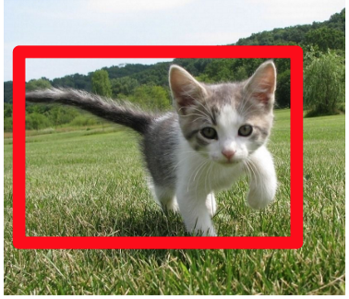
Problems in Computer Vision Image Recognition
Image Classification
Classification + Localization
Object Detection
Instance Segmentation
Semantic segmentation
Panoptic segmentation

Slide 11
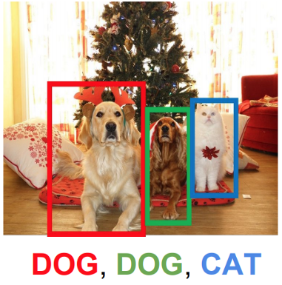
Problems in Computer Vision Image Recognition
Image Classification
Classification + Localization
Object Detection
Instance Segmentation
Semantic segmentation
Panoptic segmentation

Slide 12


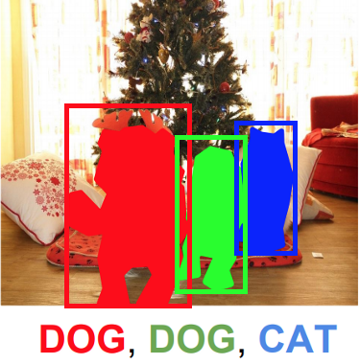

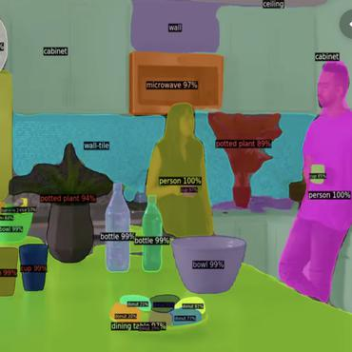
Problems in Computer Vision Image Recognition
Image Classification
Classification + Localization
Object Detection
Instance Segmentation
Semantic segmentation
Panoptic segmentation

Slide 13
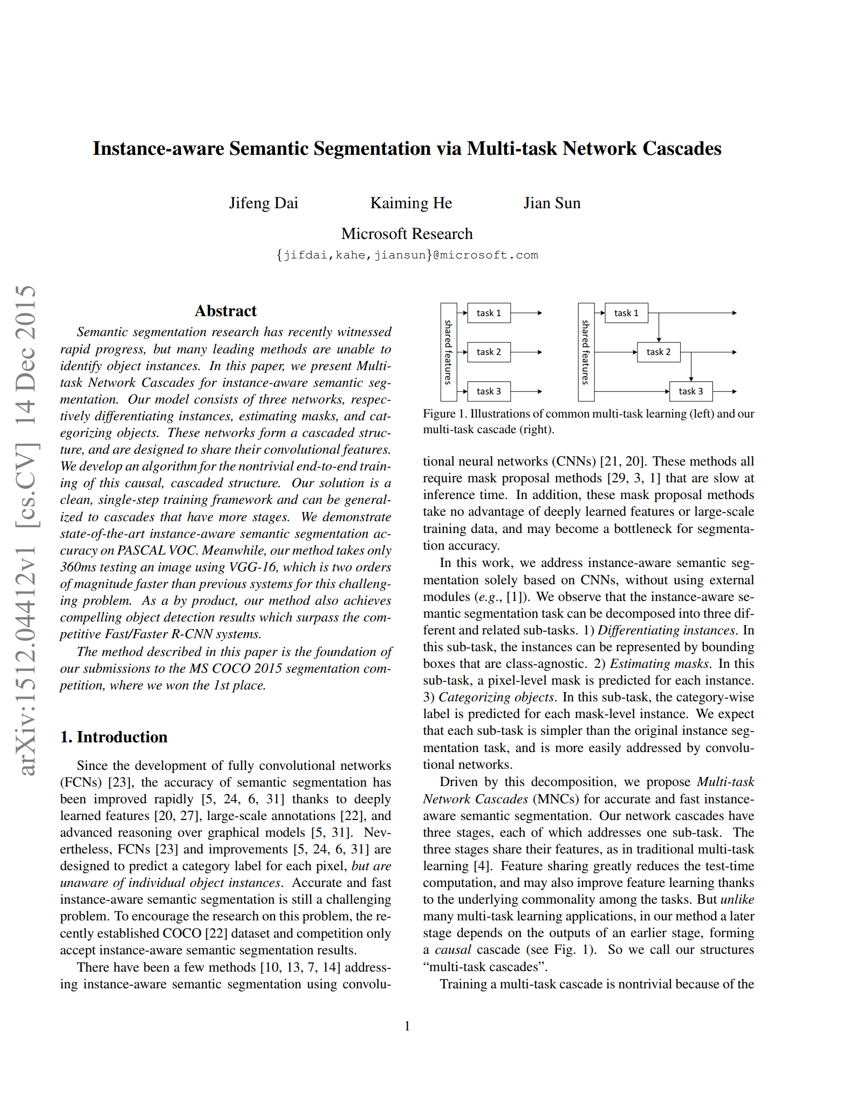
Instance-aware Semantic Segmentation

Slide 14
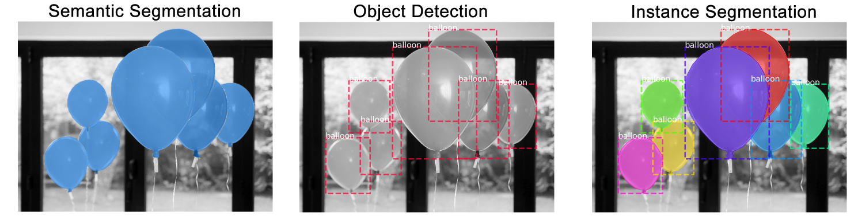
The differences
Semantic Segmentation
Object Detection
Instance Segmentation

Slide 15
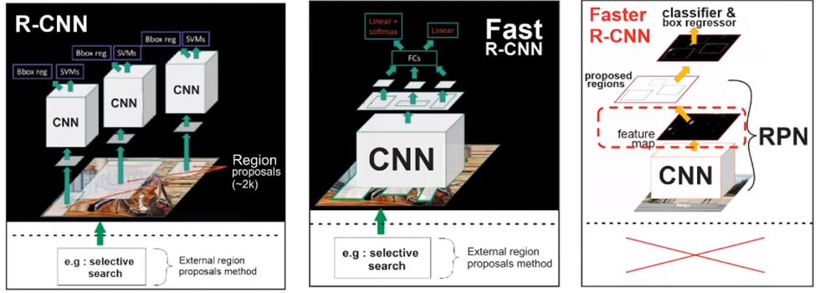
RCNN Family for Object Detection

Slide 16
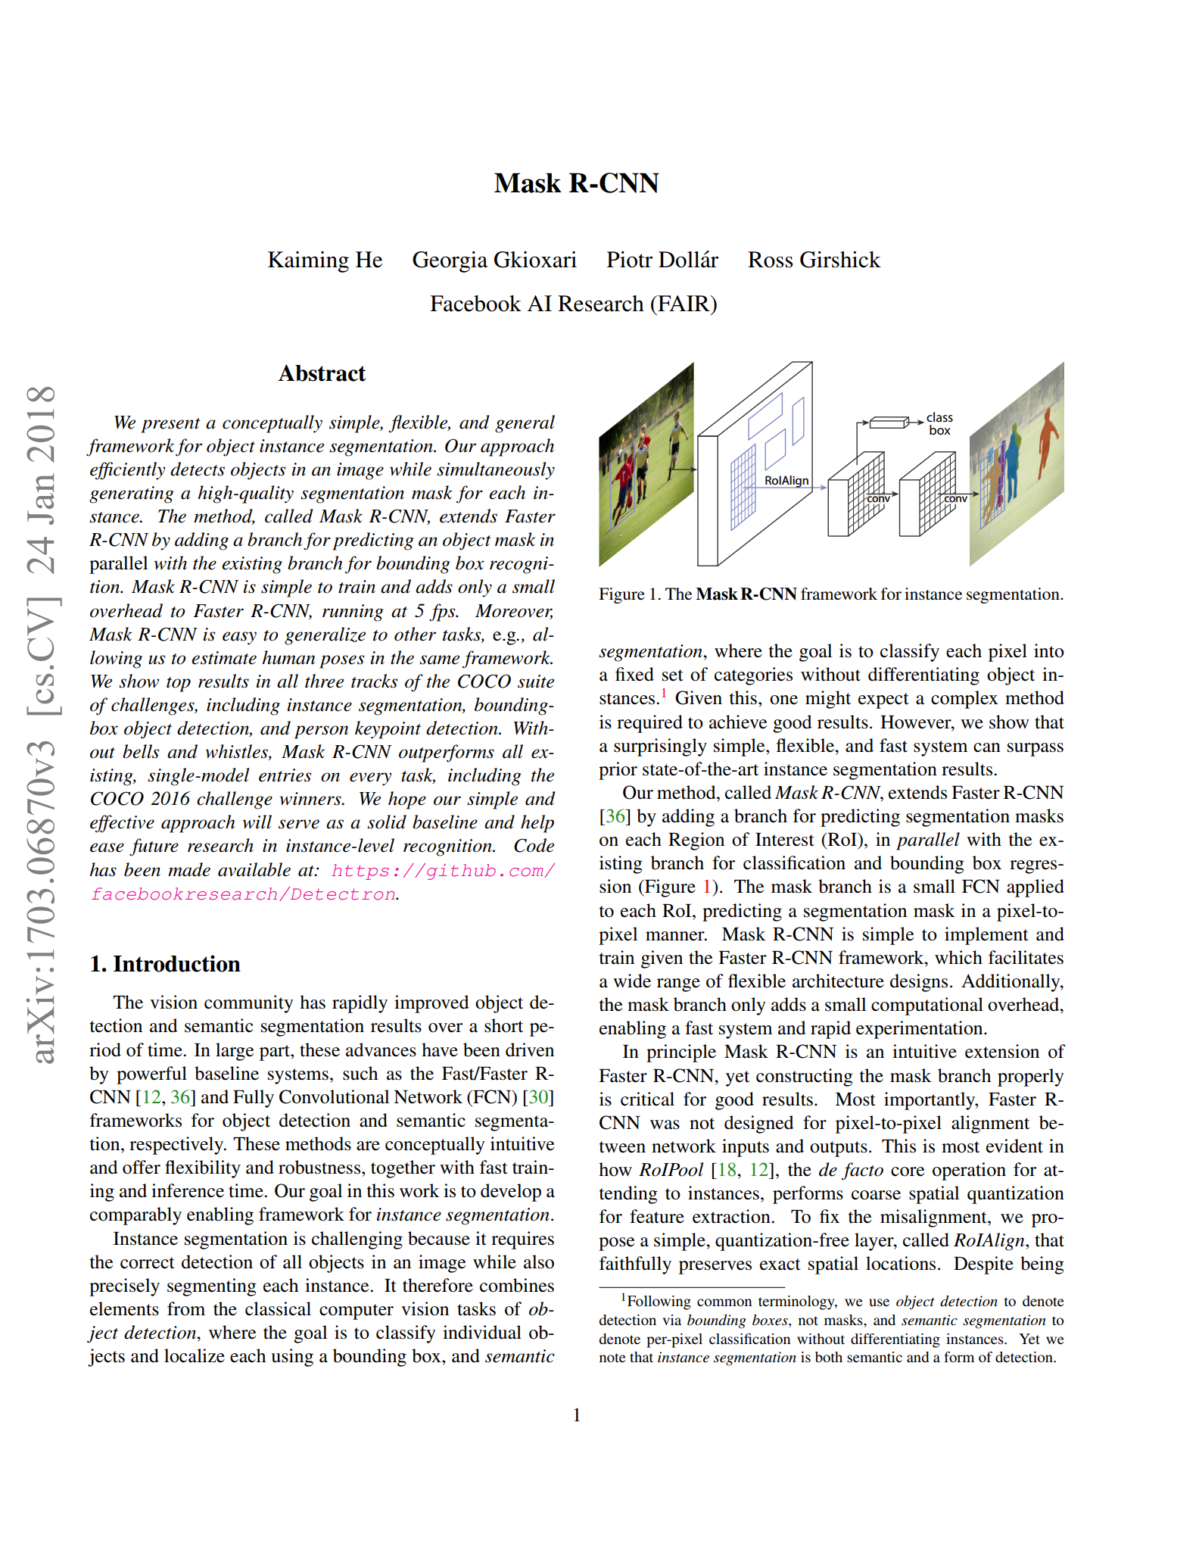
Mask R-CNN
Best Paper Award (Marr Prize) at the 16th International Conference on Computer vision (ICCV) 2017

Slide 17
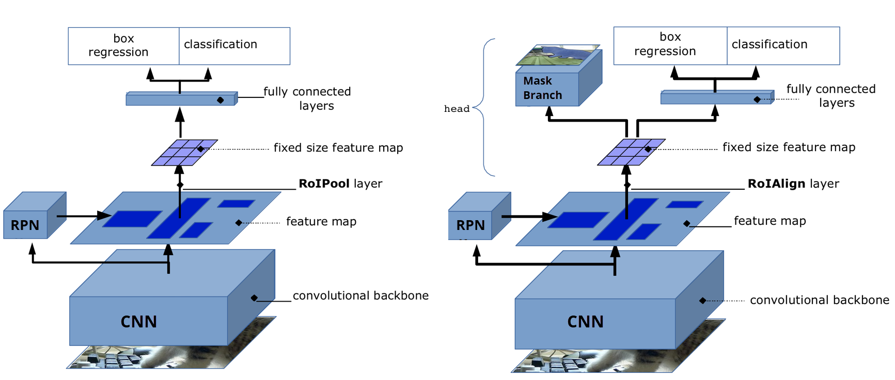
Faster R-CNN vs Mask R-CNN
Model Architecture

Slide 18
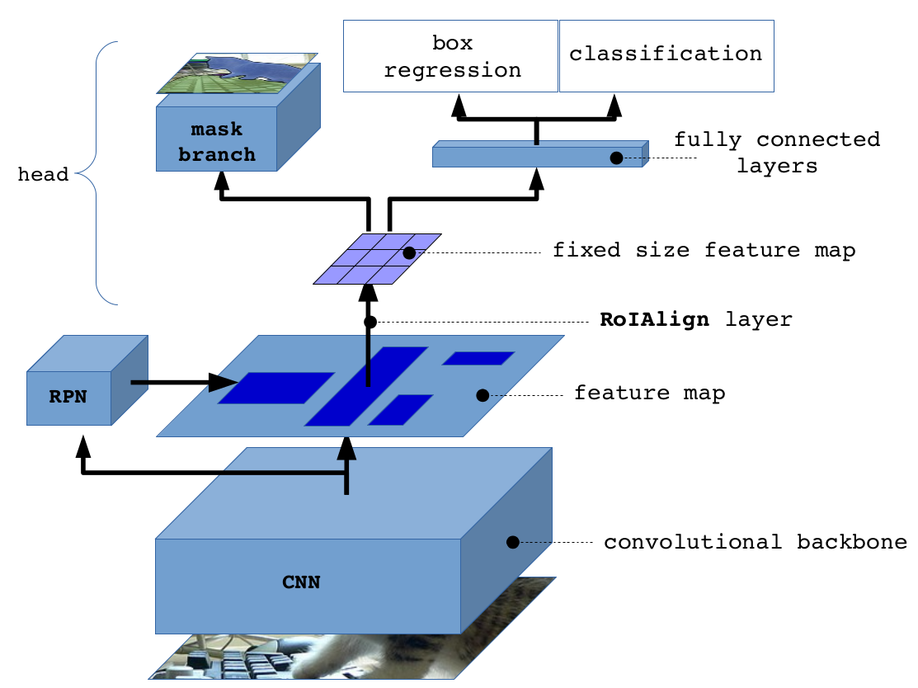
Mask R-CNN Architecture
Mask
Faster R-CNN

Slide 19


Mask R-CNN Implementation
Facebookresearch/detectron
Matterport/Mask_RCNN
Original Implementation from paper
Using Caffe2 Framework
Deprecated, move to detectron2 which is a ground-up rewrite of Detectron in PyTorch
Most Popular implementation of Mask R-CNN
Using Tensorflow v1 Framework
No Longer maintained, many compatibility issue to new tensorflow version

Slide 20
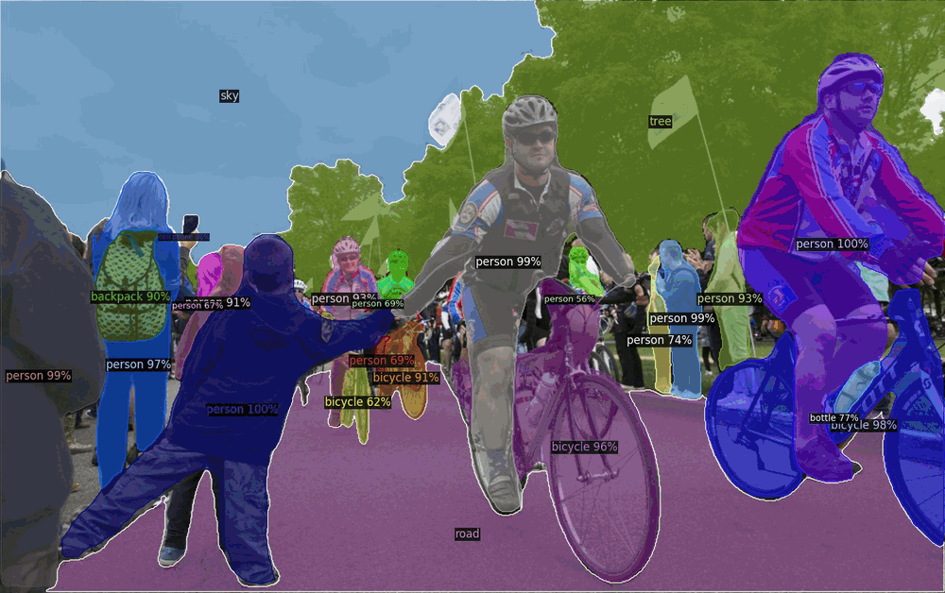

Mask R-CNN Implementation using
Detectron2 is Facebook AI Research's next generation software system that implements state-of-the-art object detection algorithms.
It is a ground-up rewrite of the previous version, Detectron, and it originates from maskrcnn-benchmark powered by the PyTorch
deep learning framework.

Slide 21
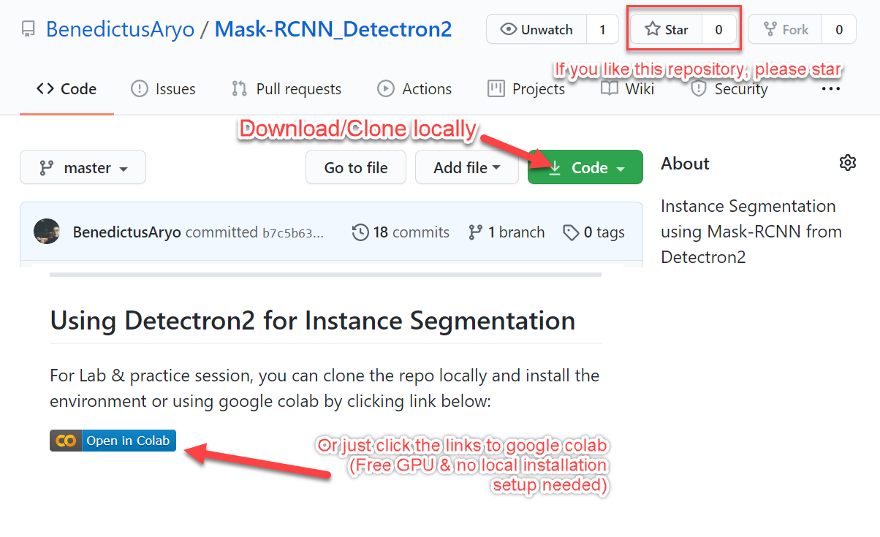
Detectron2 Lab: bit.ly/detectron2_app

